Slide 1


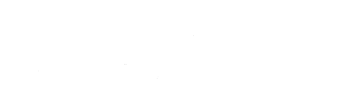
genome driven signaling heterogeneity in breast cancer
marco tognetti
BodenmillerLab
www.bodenmillerlab.com
imsb.ethz.ch/research/picotti.html
13.08.2018| overview

Slide 2
introduction I does knowing the genome solve it all?
“[…] It will revolutionize the diagnosis, prevention and treatment of most, if not all, human diseases.”
Bill Clinton, US President, 2003
2

Slide 3
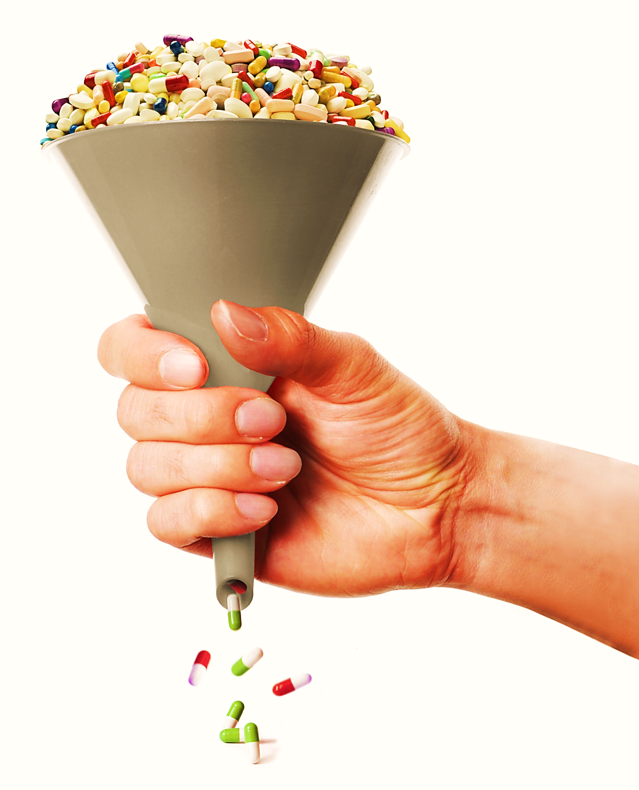
introduction I drug discovery remains as challenging as ever
3

Slide 4
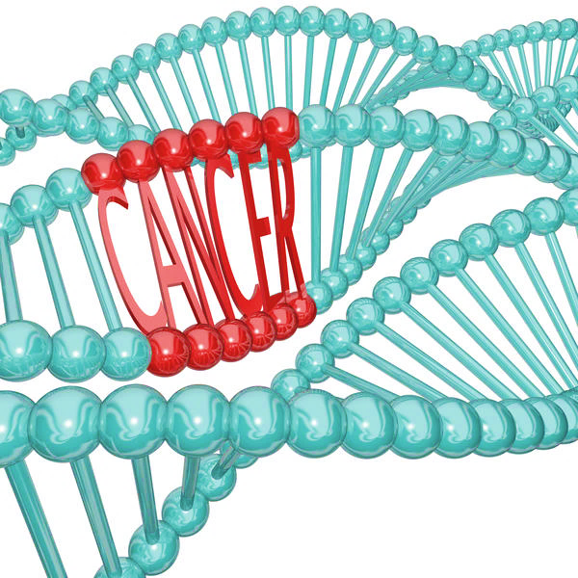
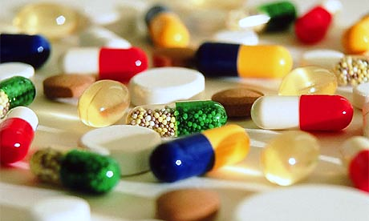

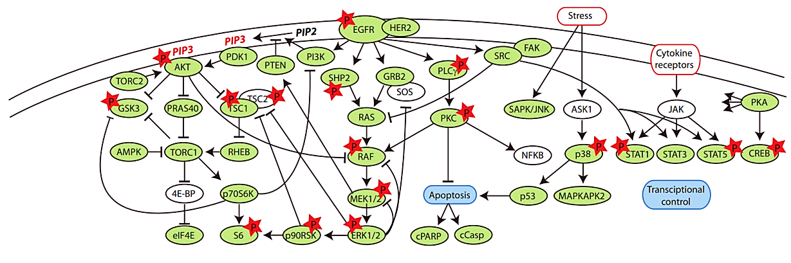
introduction I aim: establishing the genome-phenotype link
4

Slide 5
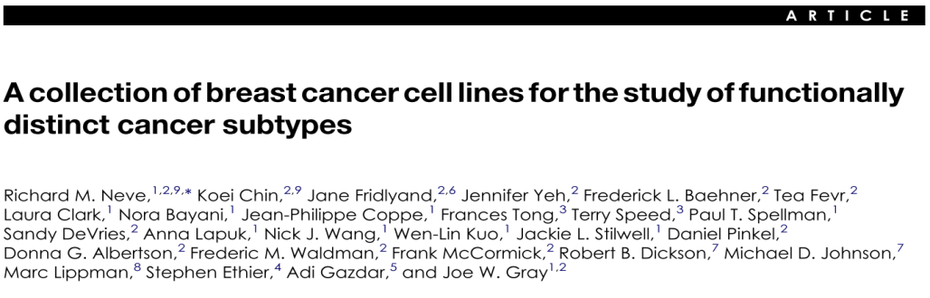
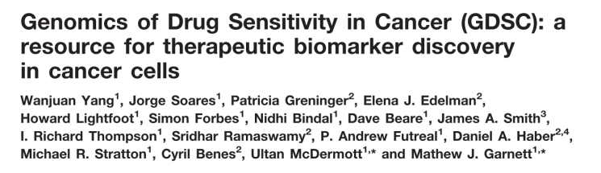
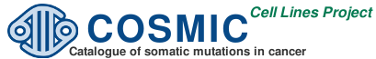

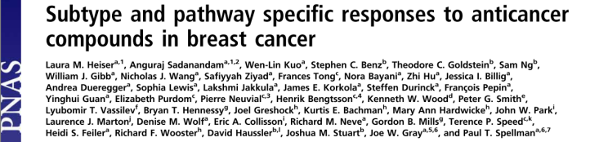
introduction I model: breast cancer cell line panel
significant
drug sensitivity
genotyped
5

Slide 6
introduction I summary
enabling personalized medicine
trough a better understanding of how cells “think”
predict drug sensitivity
classification/treatment of triple negative breast cancer
6

Slide 7
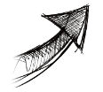
approach I why the signaling network?
highly relevant in cancer
especially in breast cancer
7

Slide 8
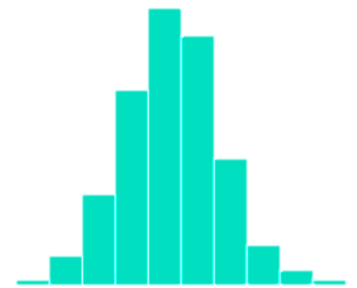


approach I how coverage: mass-cytometry multiplicity
coverage
abundance
relationships
dynamics
network plasticity
8

Slide 9
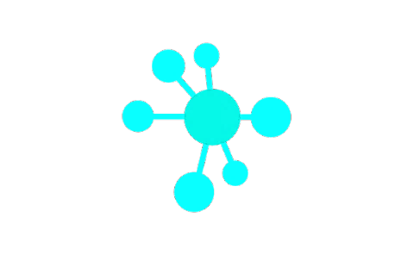
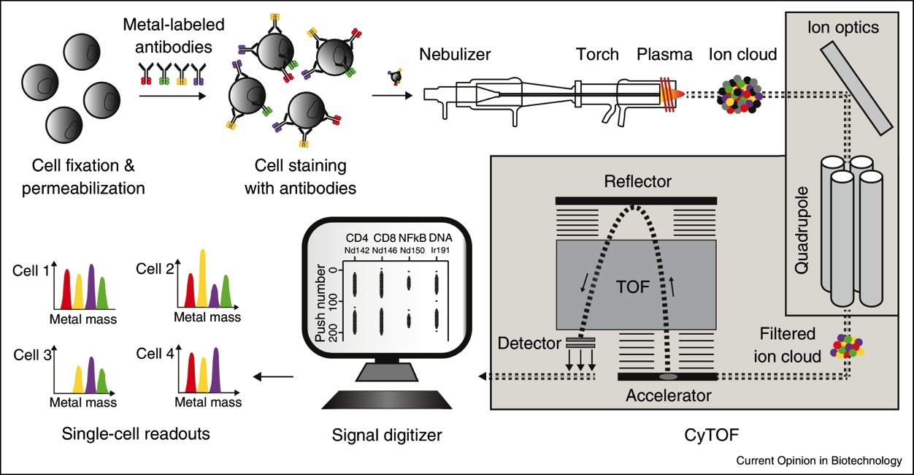
approach I method mass-cytometry: single-cell data^{(in orange)}
Di Palma S. and Bodenmiller B., Curr Opin Biotechnol (2014)
9

Slide 10
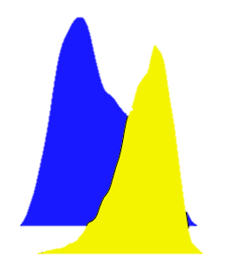
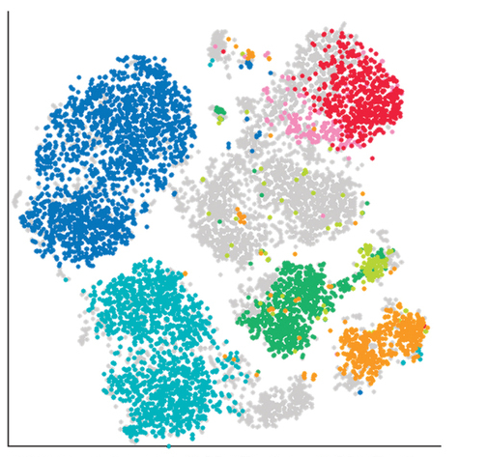
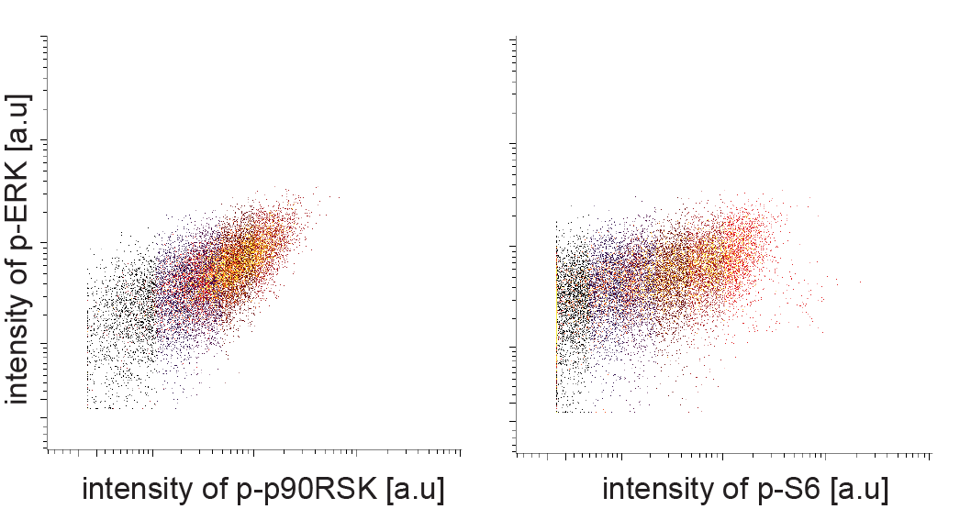
approach I what single-cell data brings
distribution
abundance
fold changes
frequency
cell cycle correction
subpopulations
intensity of p-S6
edge/relationships
Amir E. D. et al., Nat.Biotech (2013)
10

Slide 11

approach I how dynamics and network plasticity: time courses
coverage
abundance
relationships
dynamics
network plasticity
11

Slide 12



approach I linking the drug sensitivity phenotype to the genome
67 cell lines
“ground state”
dynamics
network plasticity
coverage
abundance
relationships
dynamics
network plasticity
12

Slide 13
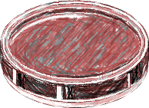
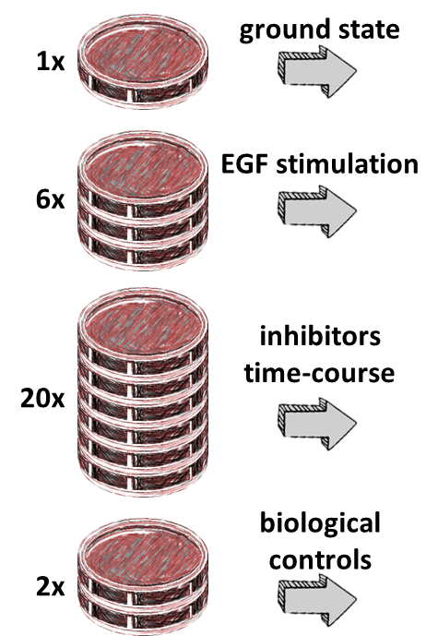
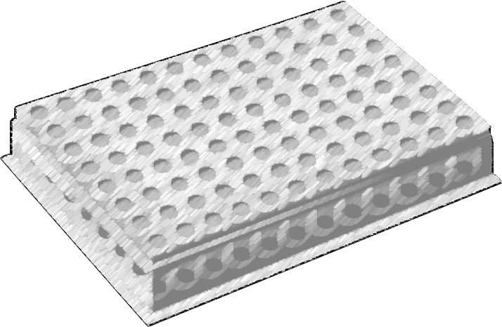
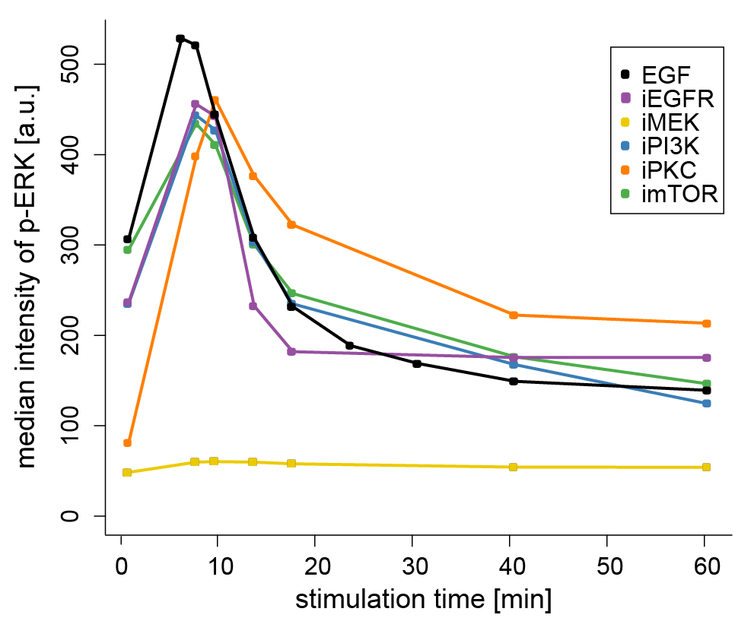
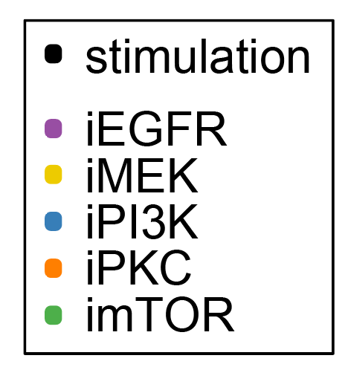
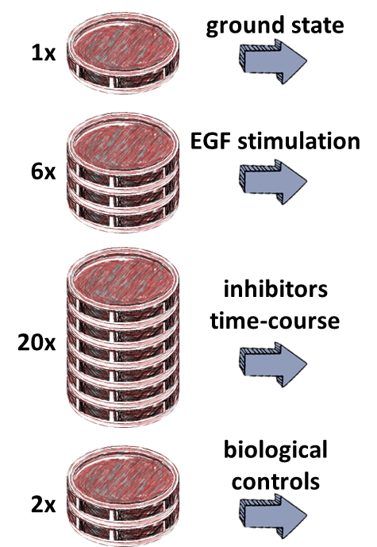
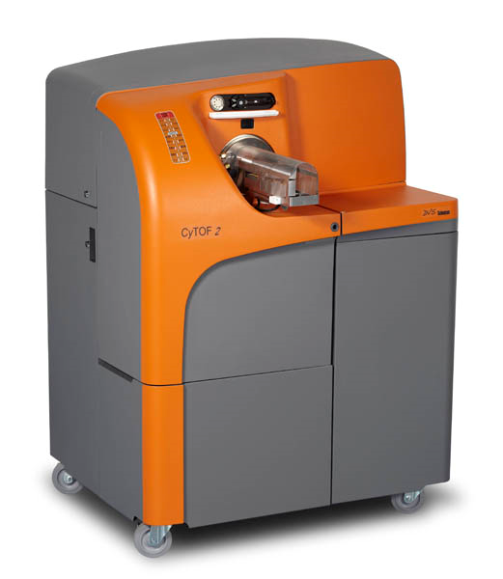
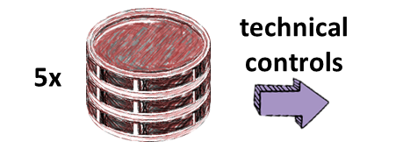
approach I experimental workflow
technical controls
5x
collection
time-course A
ground state
1x
29 samples
67x
for each cell line
EGF stimulation
barcoding and cyTOF measurement
6x
data analysis
collection
inhibitors time-course
time-course B
63 samples/cell line
total of 4221 samples
20x
40 markers at single cell resolution: 156’177 quantified markers
8 million single cells
29 samples
biological controls
2x
technical controls
5 samples
13

Slide 14
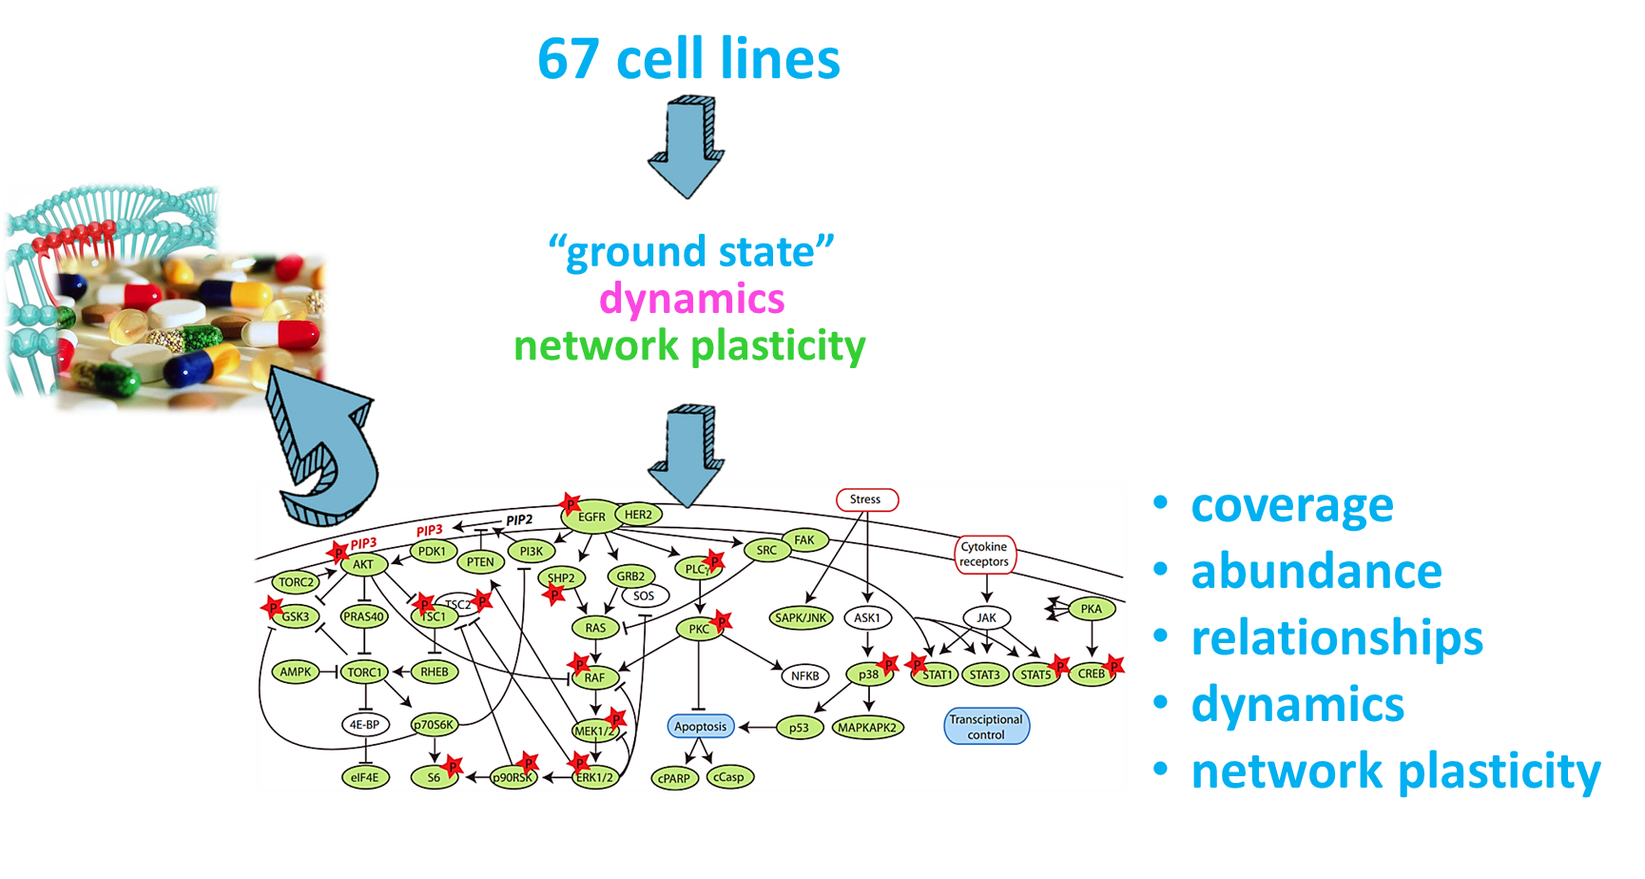
results outline I story structure and figures content
quality, trust building and DIA measurements
grouping differences
drug sensitivity
link to the genome
14

Slide 15
quality I batch effects?
technical controls
5x
collection
time-course A
ground state
1x
29 samples
67x
for each cell line
EGF stimulation
barcoding and cyTOF measurement
6x
data analysis
collection
inhibitors time-course
time-course B
63 samples/cell line
total of 4221 samples
20x
40 markers at single cell resolution: 156’177 quantified markers
8 million single cells
29 samples
biological controls
2x
technical controls
5 samples
15

Slide 16
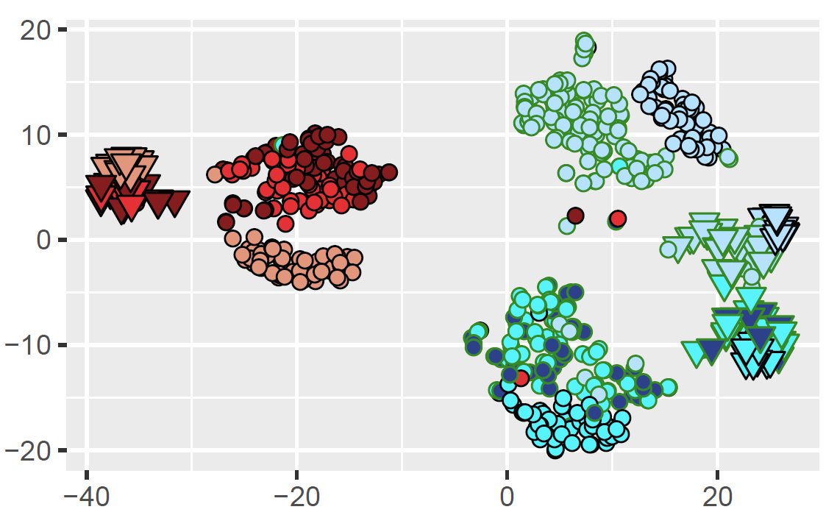
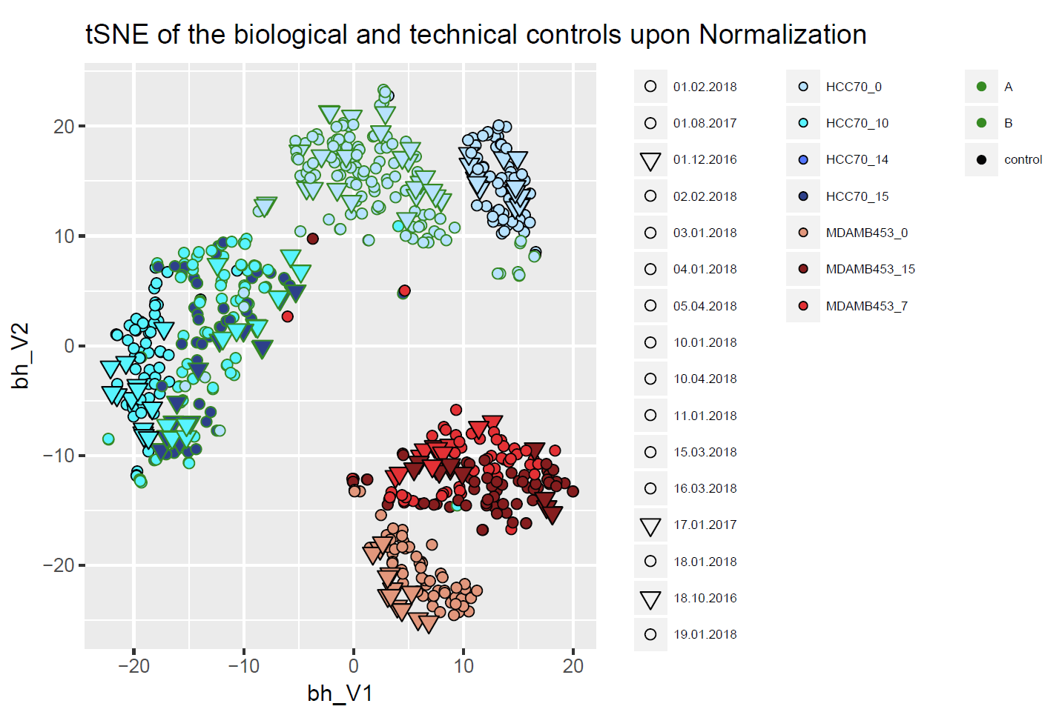
quality I batch effects?
bhSNE 2
upon correction for batch 1-3 we have the expected clustering
bhSNE 2
bhSNE 1
normalized
bhSNE 1
16

Slide 17
quality I biological reproducibility?
technical controls
5x
collection
time-course A
ground state
1x
29 samples
67x
for each cell line
EGF stimulation
barcoding and cyTOF measurement
6x
data analysis
collection
inhibitors time-course
time-course B
63 samples/cell line
total of 4221 samples
20x
40 markers at single cell resolution: 156’177 quantified markers
8 million single cells
29 samples
biological controls
2x
technical controls
5 samples
17

Slide 18
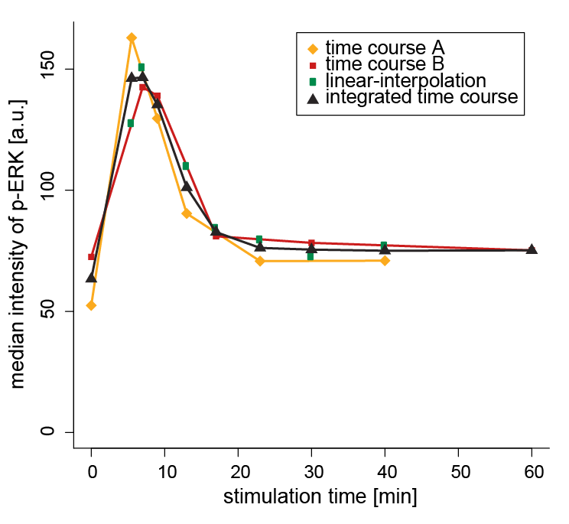
quality I biological reproducibility?
Replicate A | Replicate B
0 | 0
5.5 | 7
9 | 9
13 | 17
23 | 30
40 | 60
18

Slide 19
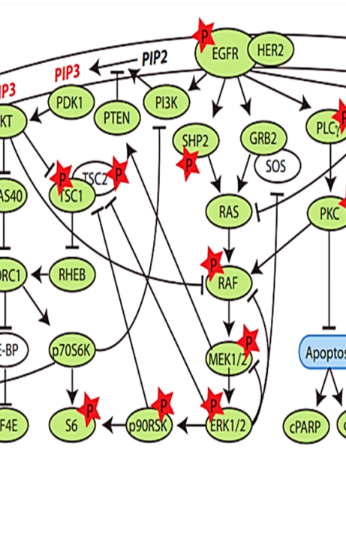
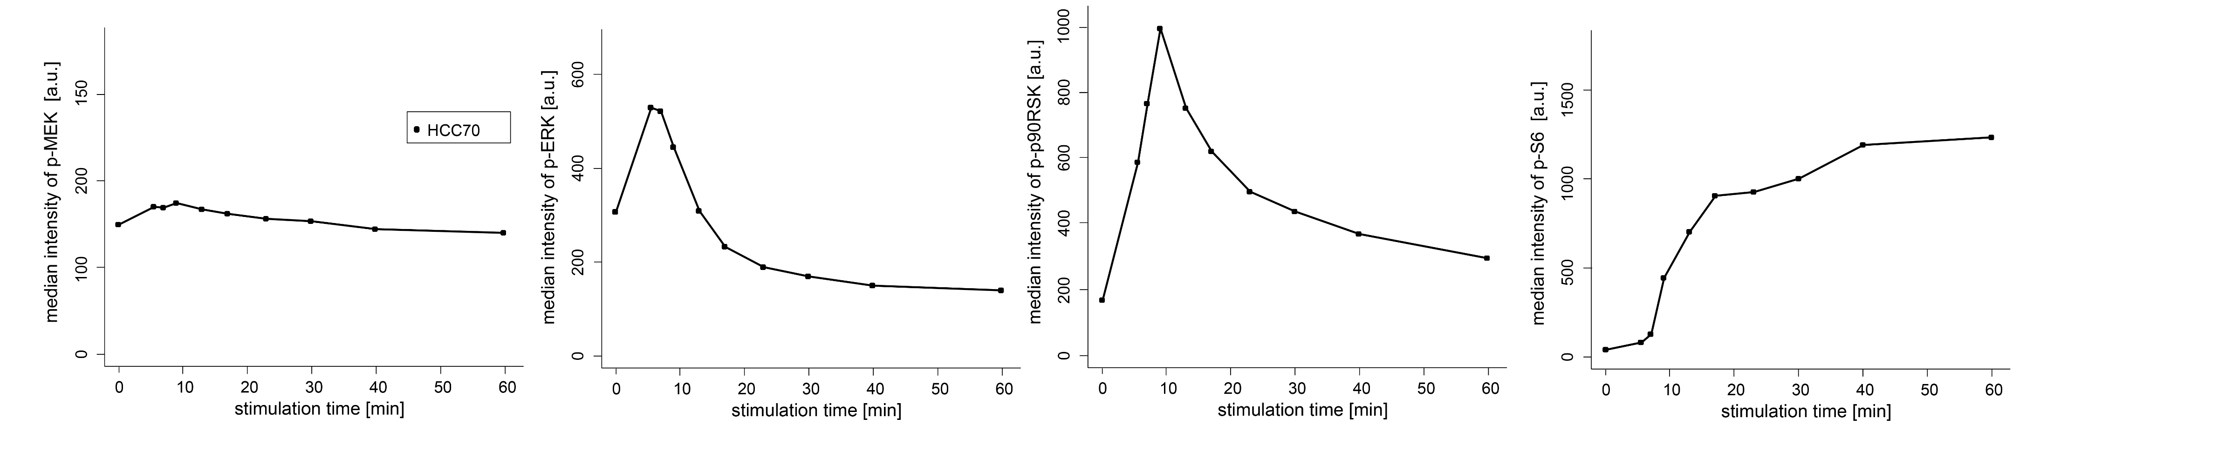
quality I multiple nodes within the same pathway
signal amplification
signal delay
19

Slide 20
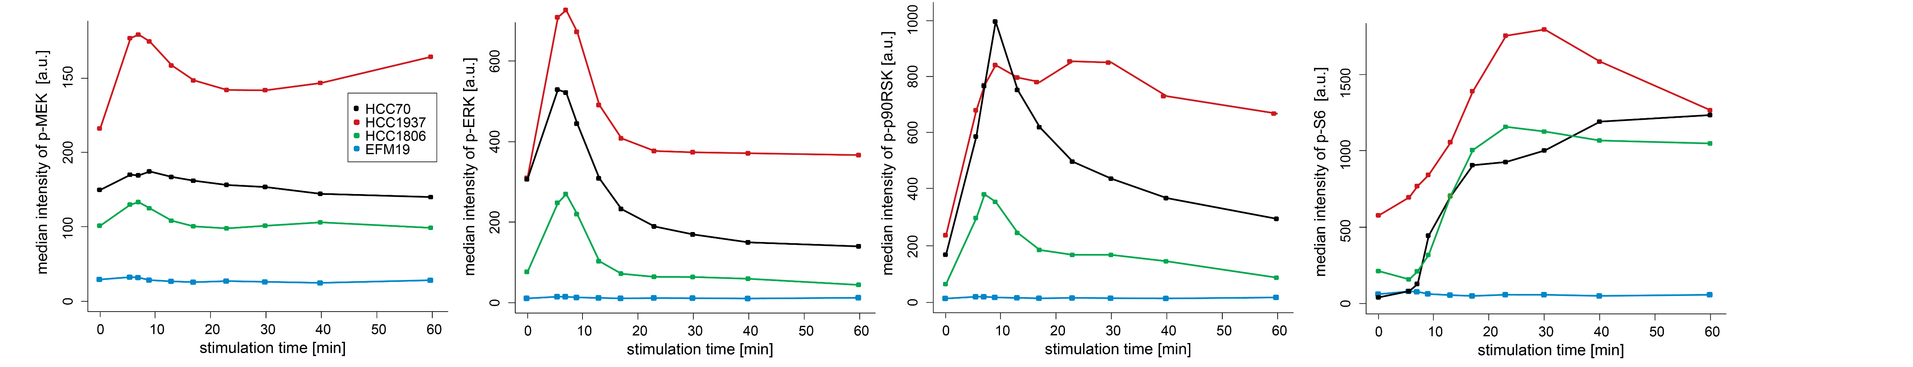
quality I different dynamics in cell lines
we observe different stimulation profiles: dynamics are important
20

Slide 21
quality I inhibitors time course
technical controls
5x
collection
time-course A
ground state
1x
29 samples
67x
for each cell line
EGF stimulation
barcoding and cyTOF measurement
6x
data analysis
collection
inhibitors time-course
time-course B
63 samples/cell line
total of 4221 samples
20x
40 markers at single cell resolution: 156’177 quantified markers
8 million single cells
29 samples
biological controls
2x
technical controls
5 samples
21

Slide 22
quality I inhibitors time course
22

Slide 23
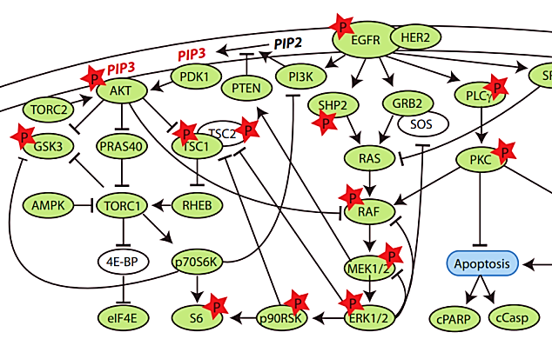
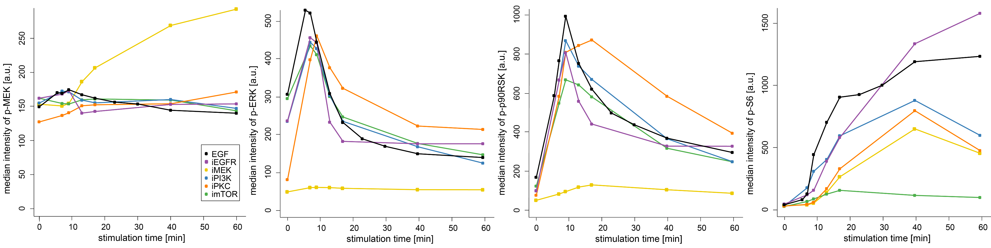
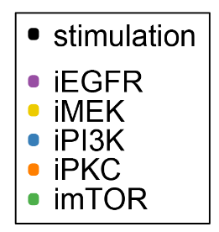
quality I very strong and specific effects
inhibitors provide mechanical insight into the network
23

Slide 24
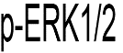
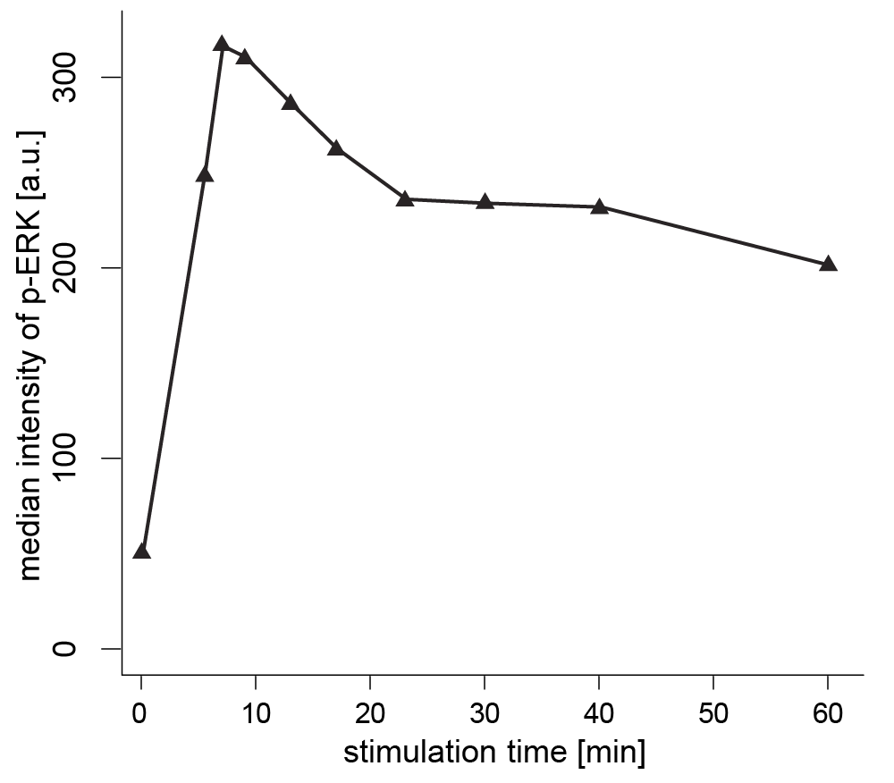
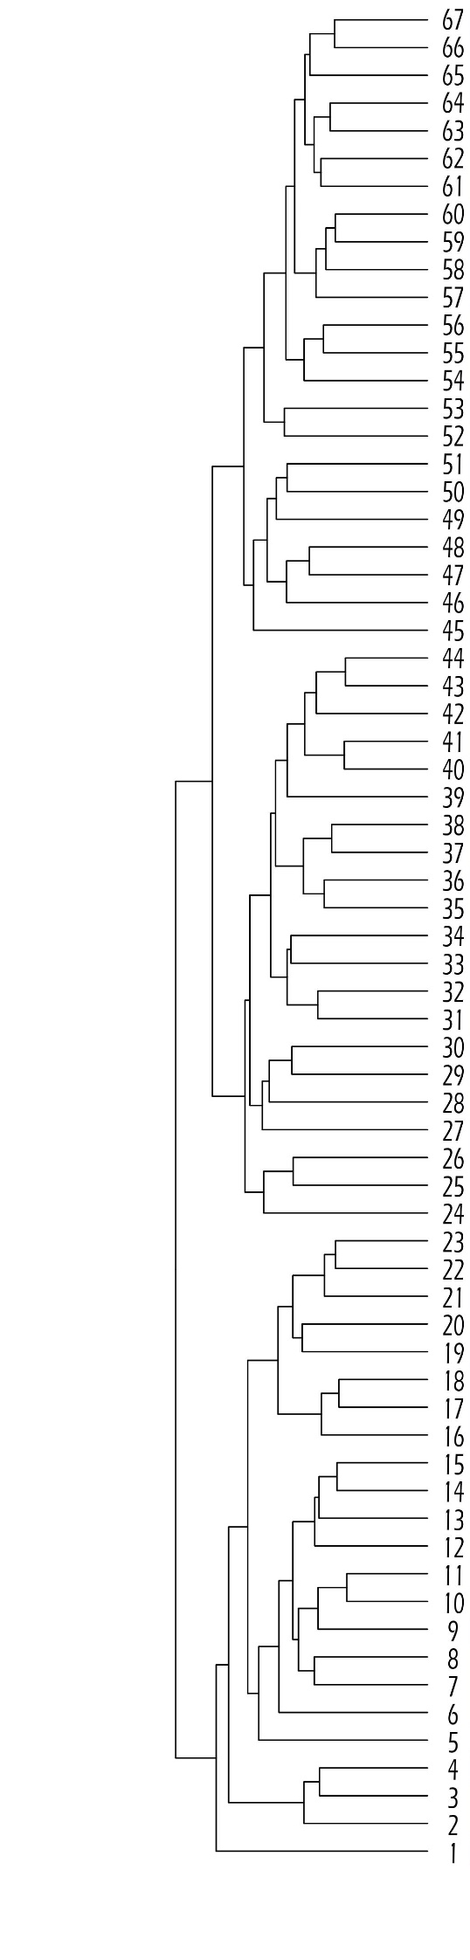
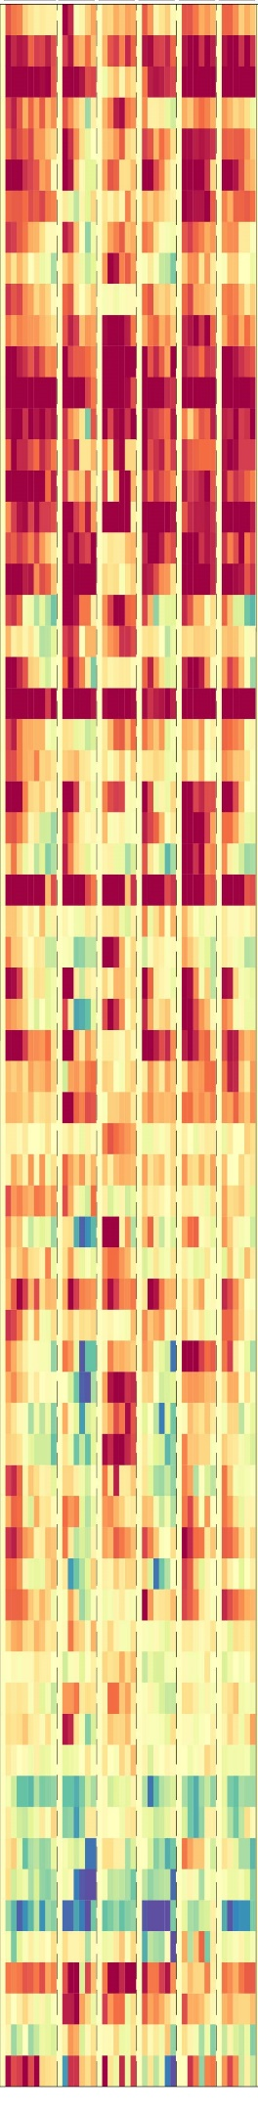
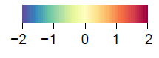
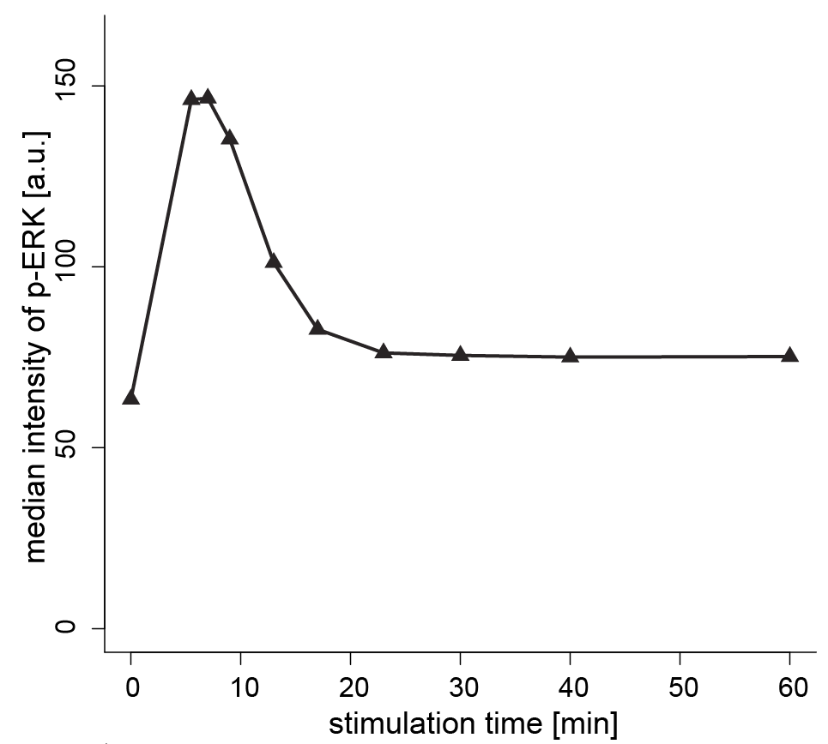
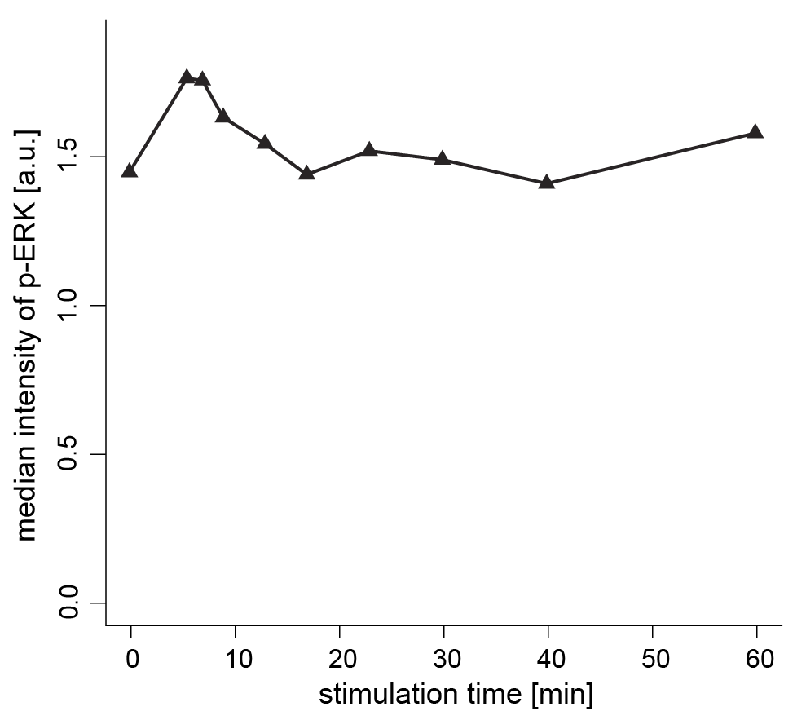
quality I EGF stimulation time course for 67 cell lines
log₂(fold change)
24

Slide 25

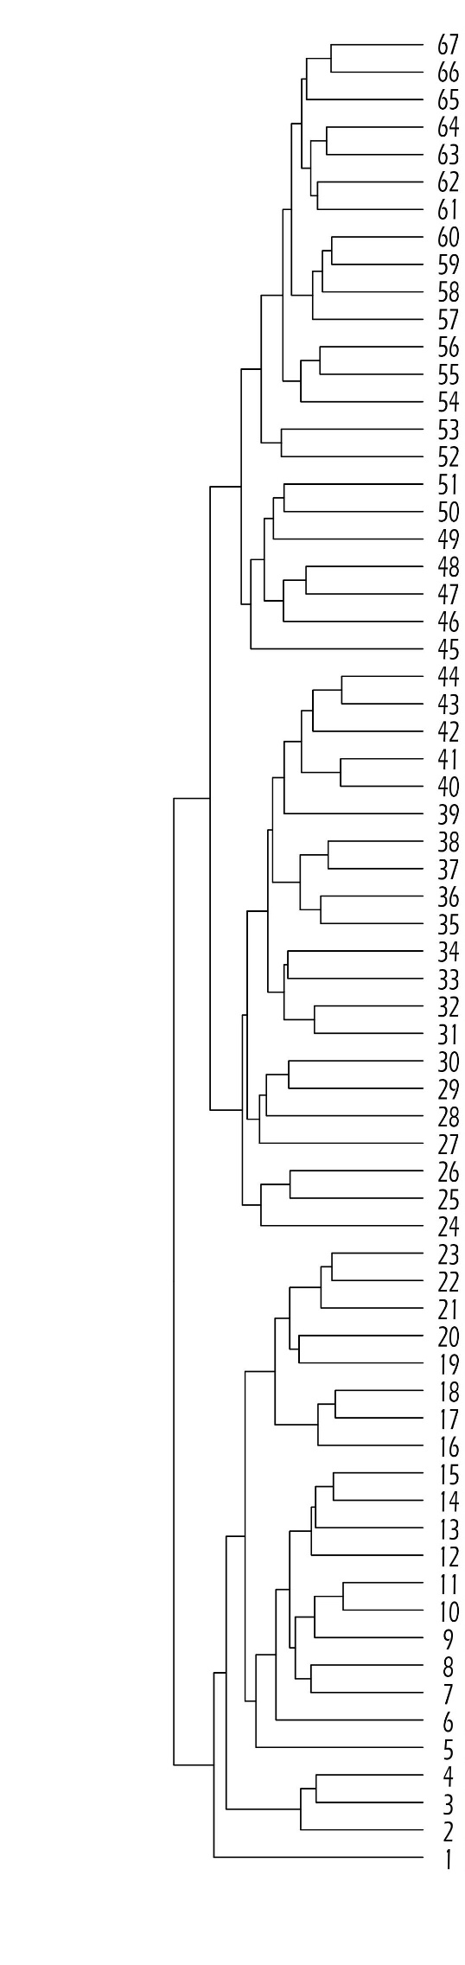
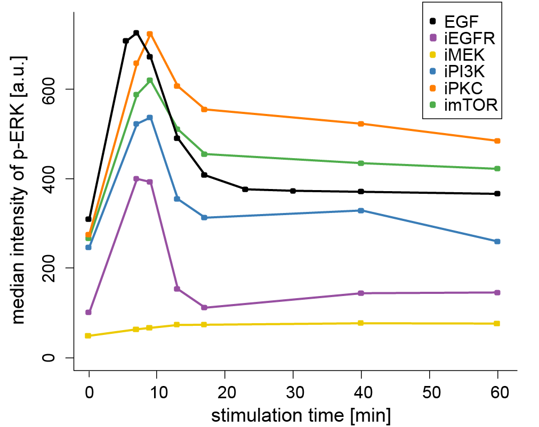
quality I adding the inhibitors time courses
log₂(fold change)
25

Slide 26
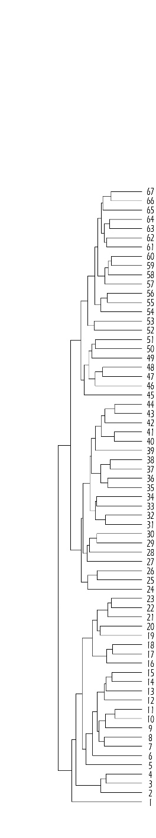
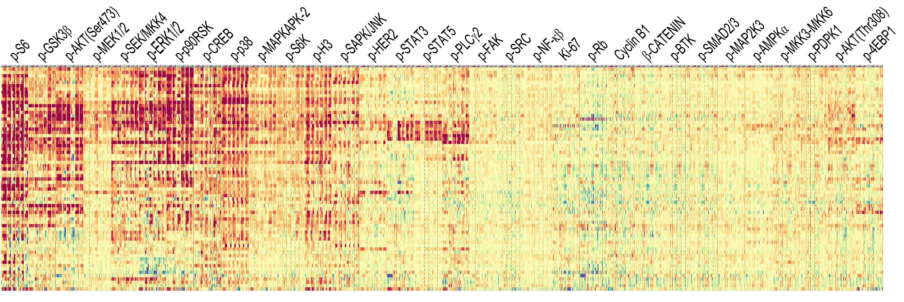
quality I cell line excitability
log₂(fold change)
cell line specific signature
26

Slide 27
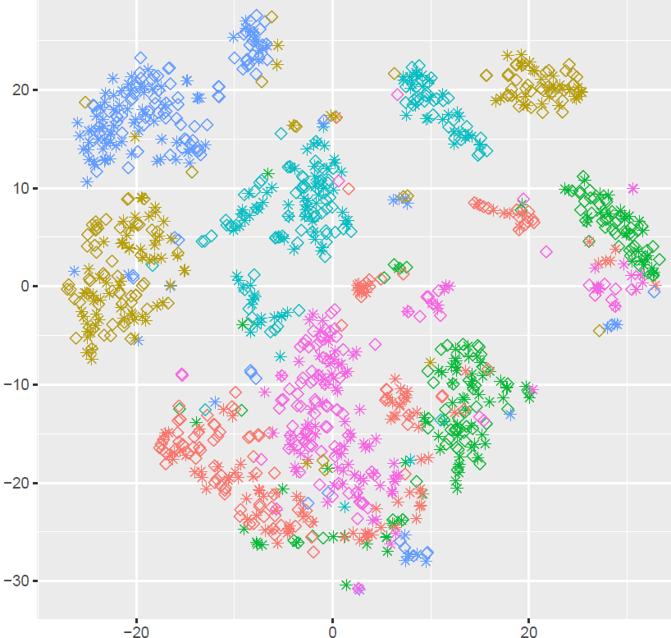
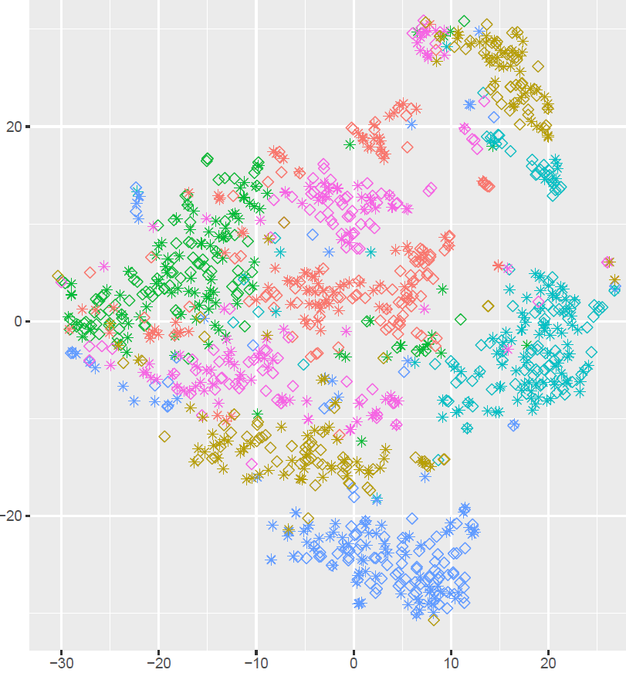
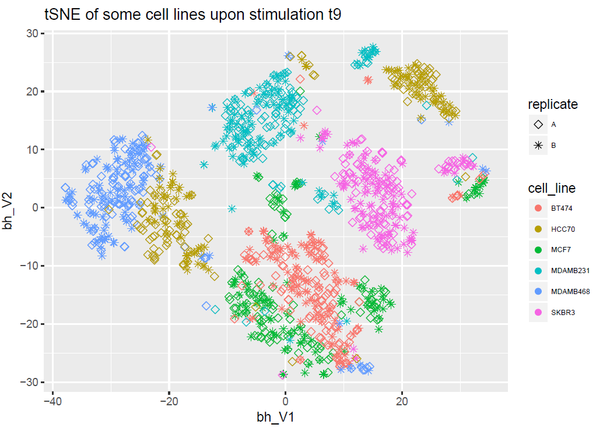
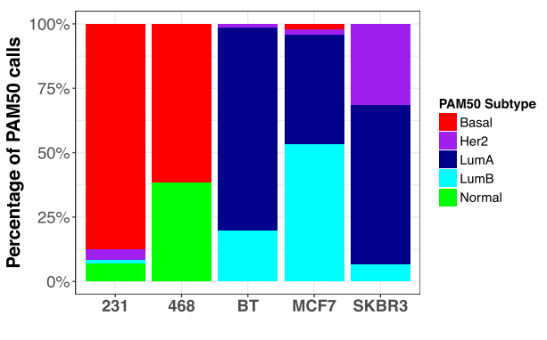
quality I single cell heterogeneity
full medium
starvation
9 min stimulation
bhSNE 2
we recapitulate the single cell heterogeneity seen in RNAseq
heterogeneity is reduced upon starvation
bhSNE 1
bhSNE 1
bhSNE 1
Roden et al. preprint
27

Slide 28
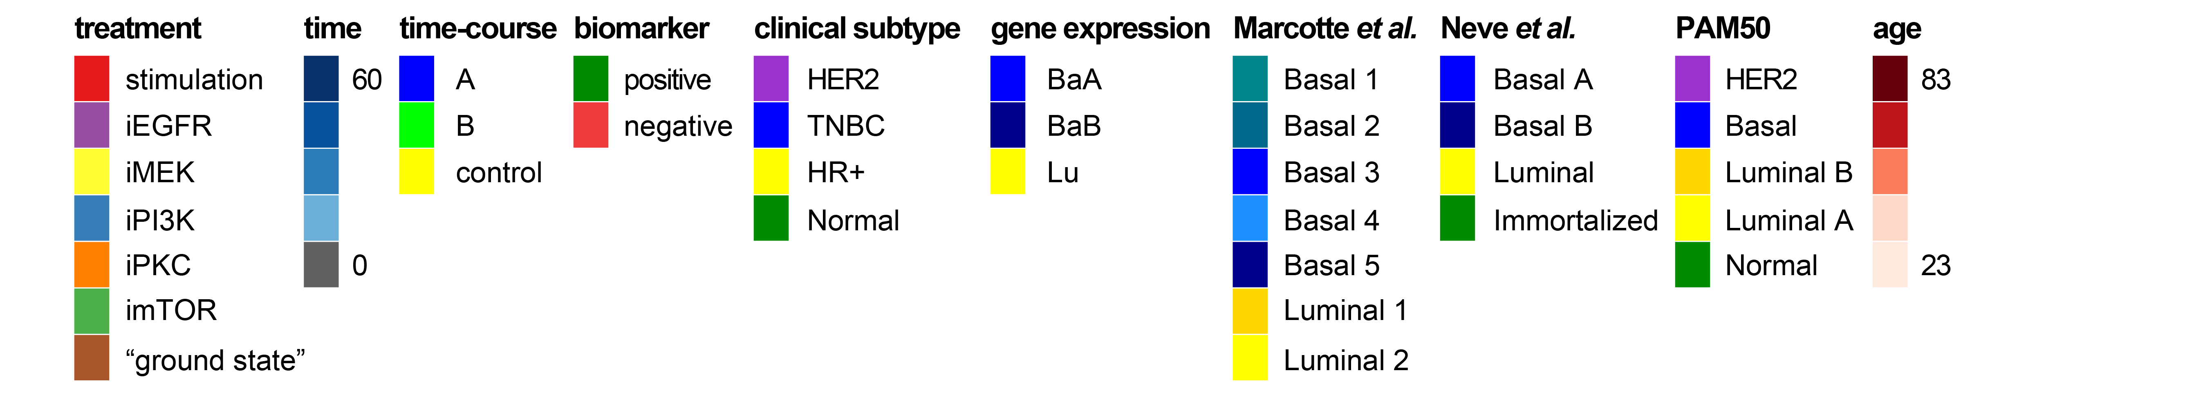

quality I unsupervised clustering
arcsinh(median intensity [a.u.]+1)
controls
PAM50
AR
HER2
PGR
ERa
time-point
treatment
cell line
mostly driven by the cell line, some receptor effect enrichment
28

Slide 29

quality I unsupervised clustering
partial correlation
controls
PAM50
AR
HER2
PGR
ERa
time-point
treatment
cell line
partial correlation seems to have a higher information content
cell-line specific clustering
some PAM50 clustering
29

Slide 30


quality I improved cell line discrimination
partial correlation
abundance
better cell line discrimination with the partial correlation measurements
30

Slide 31




quality I same analyses as for the median
highly reproducible
mostly close to zero
mostly time invariant
conserved across cell lines
31

Slide 32



quality I learn where the signal comes from
not always this trivial
32

Slide 33


quality I data accessibility
done for 6 cell lines
33

Slide 34

quality I consensus network
SAMPLE
order it in a prior-knowledge frame and calculate it for different conditions
one-sided t-test over the 72 EGF samples testing if >=0.1
34
Notes:
for each protein pair, a one-sample, one-sided t-test testing if its average partial correlation across the 72 EGF-samples is significantly higher than 0.10.1 is applied.
pMapkapk2-pH3: Mapkapk2 is known to be involved in G2/M checkpoint and pH3 is a M phase marker
pp38 and pMKK4 connection to AKT is also partly expected (especially an increase of JNK and MKK activation upon iPi3k)
pPLCg2 and pBTK is also a known connection as the pSTat5-pFAK-pSRc
there is also literature for the pSmad23-pJNK-pSTAT

Slide 35



quality I dynamics differences
obtain statistically significant different dynamics
centered on zero
35

Slide 36
quality I summary and open questions
good data quality
shiny already there but need to be expanded to the 67 cell lines
need kinetic measures (AUC, max, peak time)
further expand single cell data analyses
show overall expected stimulation profile and inhibitor response
get a network
36

Slide 37


DIA I DIA measurements
ground state
technical controls
5x
collection
time-course A
ground state
1x
29 samples
67x
for each cell line
67x
for each cell line
EGF stimulation
DIA
measurement
ground state
barcoding and cyTOF measurement
6x
data analysis
collection
inhibitors time-course
3 samples/cell line
total of 201 samples
time-course B
63 samples/cell line
total of 4221 samples
20x
40 markers at single cell resolution: 156’177 quantified markers
8 million single cells
29 samples
biological controls
2x
ground state
technical controls
5 samples
37
ground state
1x

Slide 38

DIA I DIA measurements
cell-line specific clustering (but 1)
nice TNBC/luminal clustering
high correlation between the "normal" cell lines
38

Slide 39
DIA I summary and open questions
DIA measurements look great
similar clusters as by cyTOF (par corr)
expression of the measured proteins
differences between the different breast cancer subtypes
39

Slide 40




grouping I removing the cell line effect
$$x_{ic}= x_{i}−{\overline{x}}_{cell line}$$
arcsinh(median intensity [a.u.]+1)
ERa
PGR
HER2
AR
PAM50
treatment
cell line
treatment specific clustering
40

Slide 41


grouping I adding the PAM50 effect back
$x_{ic}= x_{i}−{\overline{x}}_{cell line}$+ ${\overline{x}}_{PAM50}$
arcsinh(median intensity [a.u.]+1)
ERa
PGR
HER2
AR
PAM50
treatment
cell line
ground state stills cluster together
41

Slide 42

grouping I p-STAT3 levels across the PAM50 classifcation
HER2+ have overall lower levels of p-STAT3
TNBC have often higher levels of p-STAT3
42

Slide 43


grouping I removing the cell line effect
$$x_{ic}= x_{i}−{\overline{x}}_{cell line}$$
partial correlation
ERa
PGR
HER2
AR
PAM50
treatment
cell line
treatment specific clustering
43

Slide 44


grouping I adding the PAM50 effect back
$x_{ic}= x_{i}−{\overline{x}}_{cell line}$+ ${\overline{x}}_{PAM50}$
partial correlation
ERa
PGR
HER2
AR
PAM50
treatment
cell line
PAM50 specific clustering except in ground state and iMEK in luminal/HER2
44

Slide 45
grouping I summary and open questions
we have some nice preliminary analyses
show how the different breast cancer subtypes behave at the signaling level
pinpoint at the major differences
possibly subtype the TNBC
45

Slide 46


sensitivity I what is the aim?
Drug sensitivity prediction
with protein levels
with par corr
with kinetic features
…
compare to
genomic
transcriptomic
functional genomics
receptor levels
…
LASSO
ANOVA
46

Slide 47
sensitivity I LASSO with stability selection
using either Median or Par. Corr. for the average on treatment at either time-point 0 or >0 (12 conditions)
6 drug sensitivity statistics for 99 drugs (with 20 points)
GEC50: similar to EC50, the drug concentration of drug at half maximal effect (relevant for low potency drugs, GR < 0.5)
GR50: drug potency, the drug concentration at which GR=0.5
GR_AOC: the integrated drug effect across a range of concentrations
GR Hill Coefficient: the steepness of the dose-response curve
GRmax: drug efficacy, the GR value at the maximum tested drug concentration: between -1 and 1. Negative values: cytotoxicity. Positive values: cell growth. Zero: cytostatic effect (no net growth).
GR r2: the goodness of the fit
do a PCA (or sparse PCA) to limit the number of features (as the method is sensitive to the number of features given to the model) and take the first 2,4,5,30 components for the model
retrieve the markers above a threshold (0.6, Sparsity) and fit a linear model to them (adjR2)
repeat the process with n-1 cell lines for a leave-one-out-cross-validation (q2)
47
Notes:
GR is a cell survival measurement corrected for the cell cycle (cells cycling very slowly are not included):

Slide 48

sensitivity I leave-one-out cross-validation
we have some good ones but not really good especially upon LOO-CV
48

Slide 49
sensitivity I ANOVA the clusters
cluster and cut based on either Median or Par. Corr. for the average on treatment at either time-point 0 or >0 (12 conditions)
6 drug sensitivity statistics for 99 drugs (with 20 points)
better define the clusters (manually?) otherwise clusters often contain only few cell lines
easier to compare with other data (just need the clusters)
overall par. corr. seems to generate more significant clusters
49

Slide 50

sensitivity I one good example
50

Slide 51

sensitivity I iPKC time-point 0 Par Corr
Trichostatin.A is a mammalian histone deacetylase inhibitor
an interplay of PKC and histone deacetylase 1 is known
51

Slide 52
sensitivity I summary and open questions
we have some very preliminary results but the field is very complex and need help in the model building
show how good our data predict drug sensitivity
which conditions are more informative
which features are more informative
compare to already used datasets (RNAseq)
52

Slide 53

genome I QTL mapping
trait (drug, protein, …)
genes
nothing significant
cell lines
SNPs
ranking
direct mutation
within the KEGG network
within the STRING network
within the transcriptomic network
CNVs
53

Slide 54

genome I summary and open questions
me and Jonas will learn QTL mapping from Andreas’s group
find genomic aberrations that explain cyTOF traits that in turn are predictive for drug sensitivity
54

Slide 55
outlook I what the future holds
one paper on 6 cell lines focusing on the inhibitor response
learning eQTL from our side
55

Slide 56







summary I the data is here the analysis slowly taking shape
56

Slide 57



Xiaohui Wu
Beyer Lab
Andreas Beyer
Konstantina Charmpi
Xiaohui Wu
Bodenmiller Lab
thank you!
Picotti Lab

